Slide 1
UNIT IV
Association:Basic Concepts and Algorithms

Slide 2
Contents:
Problem Definition,
Frequent Item Set generation,
Rule Generation,
Compact Representation of frequent item sets,
FP-Growth Algorithm.

Slide 3
Association: Problem Definition
Market Basket Analysis: A Motivating Example:
This process analyzes customer buying habits by finding associations between the different items that customers place in their “shopping baskets”.
The discovery of such associations can help retailers develop marketing strategies by gaining insight into which items are frequently purchased together by customers.

Slide 4
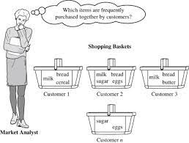
Association: Problem Definition

Slide 5
Example
For instance, if customers are buying milk, how likely are they to also buy bread (and what kind of bread) on the same trip to the supermarket? Such information can lead to increased sales by helping retailers do selective marketing and plan their shelf space.

Slide 6
Example
Association analysis. Suppose, as a marketing manager of AllElectronics, you would like to determine which items are frequently purchased together within the same transactions.
An example of such a rule, mined from the AllElectronics transactional database, is
buys(X; “computer”))buys(X; “software”) [support = 1%; confidence = 50%]
where X is a variable representing a customer

Slide 7

Association Rule Mining
Given a set of transactions, find rules that will predict the occurrence of an item based on the occurrences of other items in the transaction
Market-Basket transactions
Example of Association Rules
{Diaper} → {Beer},
{Milk, Bread} → {Eggs,Coke},
{Beer, Bread} → {Milk},
Implication means co-occurrence, not causality!

Slide 8

Definition: Frequent Itemset
Itemset
  A collection of one or more items
    Example: {Milk, Bread, Diaper}
  k-itemset
    An itemset that contains k items
Support count (σ)
  Frequency of occurrence of an itemset
  E.g. σ({Milk, Bread,Diaper}) = 2
Support
  Fraction of transactions that contain an itemset
  E.g. s({Milk, Bread, Diaper}) = 2/5
Frequent Itemset
  An itemset whose support is greater than or equal to a minsup threshold

Slide 9
Frequent Itemsets, Closed Itemsets, and Association Rules
Let I = {I1, I2,..., Im} be a set of items. Let D, the task-relevant data, be a set of database transactions where each transaction T is a set of items such that T ⊆ I.
Each transaction is associated with an identifier, called TID.
Let A be a set of items. A transaction T is said to contain A if and only if A ⊆ T. An association rule is an implication of the form A ⇒ B, where A ⊂ I, B ⊂ I, and A∩B = φ

Slide 10
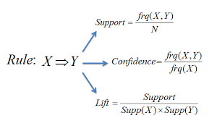
Frequent Itemsets, Closed Itemsets, and Association Rules

Slide 11
Frequent Itemsets, Closed Itemsets, and Association Rules
The rule A ⇒ B holds in the transaction set D with support s, where s is the percentage of transactions in D that contain A∪B (i.e., the union of sets A and B, or say, both A and B). This is taken to be the probability, P(A∪B).
The rule A ⇒ B has confidence c in the transaction set D, where c is the percentage of transactions in D containing A that also contain B. This is taken to be the conditional probability, P(B|A).

Slide 12
Frequent Itemsets, Closed Itemsets, and Association Rules
Rules that satisfy both a minimum support threshold (min sup) and a minimum confidence threshold (min conf) are called strong. By convention, we write support and confidence values so as to occur between 0% and 100%, rather than 0 to 1.0

Slide 13
Frequent Itemsets, Closed Itemsets, and Association Rules
A set of items is referred to as an itemset. An itemset that contains k items is a k-itemset.
The set {computer, antivirus software} is a 2-itemset. The occurrence frequency of an itemset is the number of transactions that contain the itemset. This is also known, simply, as the frequency, support count, or count of the itemset.

Slide 14
Association Rules
Once the support counts of A, B, and A∪B are found, it is straightforward to derive the corresponding association rules A⇒B and B⇒A and check whether they are strong.
Thus the problem of mining association rules can be reduced to that of mining frequent itemsets. In general, association rule mining can be viewed as a two-step process:
1. Find all frequent item sets: By definition, each of these item sets will occur at least as frequently as a predetermined minimum support count, min sup.
2. Generate strong association rules from the frequent item sets: By definition, these rules must satisfy minimum support and minimum confidence.

Slide 15
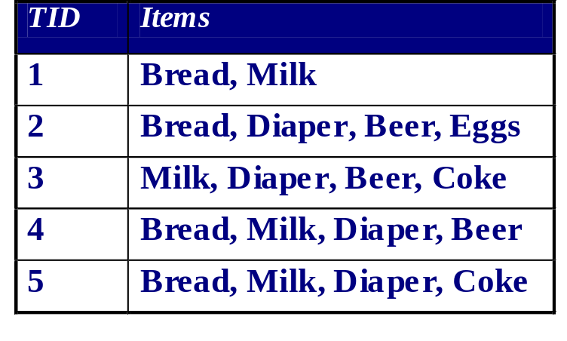

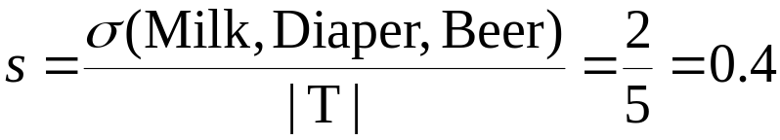

Example: Association Rule
Association Rule
  An implication expression of the form X → Y, where X and Y are itemsets
  Example:
  {Milk, Diaper} → {Beer}
Rule Evaluation Metrics
  Support (s)
    Fraction of transactions that contain both X and Y
  Confidence (c)
    Measures how often items in Y
    appear in transactions that
    contain X
Example:

Slide 16
Thank You

